Slide 1
Gene expression analysis
PSL374
Brian Cox, PhD
Instructor

Slide 2
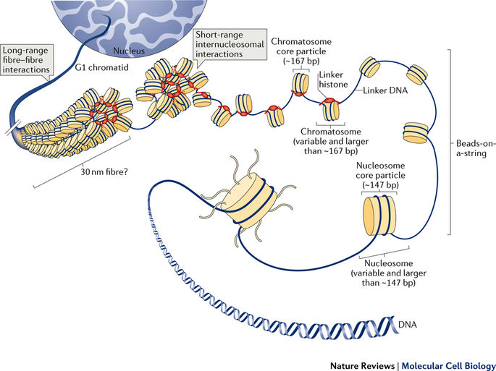
Genome

Slide 3
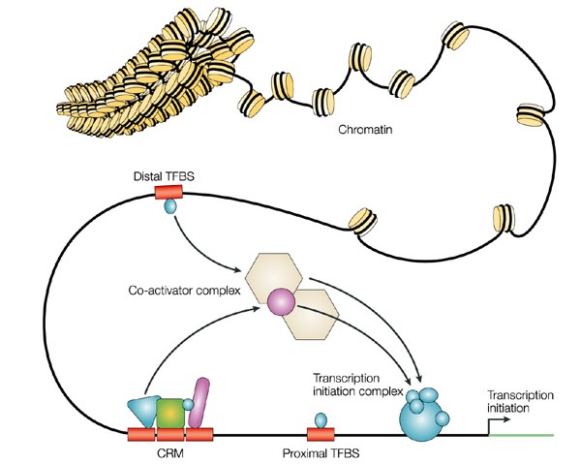
Gene expression is regulated
Different regions of the genome
Co-ordinate expression
Activators, repressors
Enhancers, promoter
Wyeth W. Wasserman & Albin Sandelin
Nature Reviews Genetics 5, 276-287 (2004)

Slide 4
Transcriptome, the transcribed genome
In the case of gene expression we are looking only at the transcribed regions (exons)
Total of all expressed RNA is the transcriptome
Transcribed but, spliced out are the introns
Introns can contain other used transcription products like small RNAs (microRNAs and piwi RNA)
promoter
intron
TSS – transcriptional start site
UTR – untranslated region, does not code for protein, but important for regulation of the RNA
TSS
DNA
5’ UTR
exon
3’ UTR

Slide 5
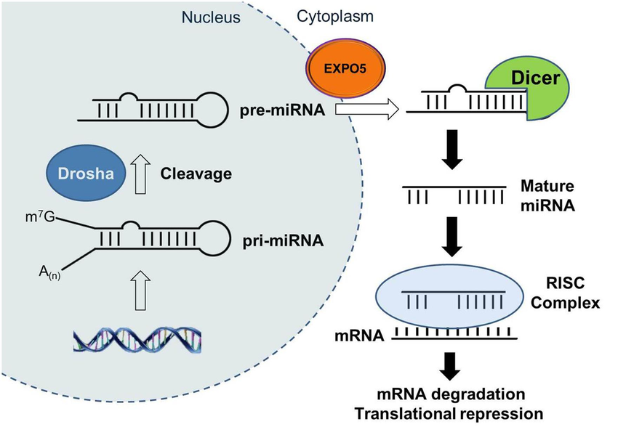
Transcriptome is more than protein coding
RNA can be one of two kinds
Protein coding
Loads on to the ribosome for translation
Non-coding
Long non-coding RNA, 1000s of bases long
XIST (X inactivation in females), rRNA (functional parts of the ribosome)
Small non-coding RNAs, 100s of bases when transcribed but processed by nucleases into 19-14 base final product
microRNAs, Piwi, tRNA
Pseudogenes, variable 100s to 1000s of bases long
Lost reading frame, will not make a protein
Spliced and unspliced mRNAs

Slide 6
Gene expression analysis
By sequencing the RNA what kinds of analyses can be performed?

Slide 7
Experimental design
A quality experiment involves 3 main things:
The Question
2) The Sample Size
(power)
3) The Controls
Questions on the unique characteristics and functions of a population, tissues, cells etc
Do you have enough samples to detect a difference? Considers noise of samples and technique.
How do you know the experiment worked/failed?
That the effect is biologically relevant?

Slide 8
Power analysis/ Sample size
Two issues, detection and quantification
Detection
Is the gene or transcript present/absent?
Quantification
Is there more or less between groups
Power to detect differences
This is proportional to the variance (mu)
High variance needs more samples to be certain of a difference
Low variance needs fewer samples
Often we start with a few sample to determine how many samples are needed

Slide 9
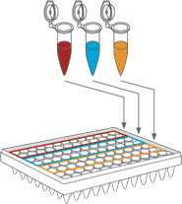
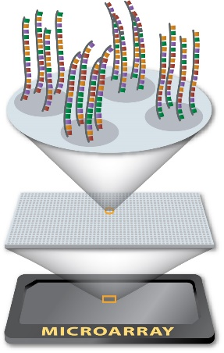
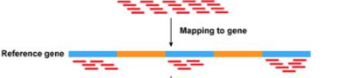
Comparison of techniques
RNA-Sequencing
qPCR
Microarray
Targeted method
Genome wide
Genome wide

Slide 10
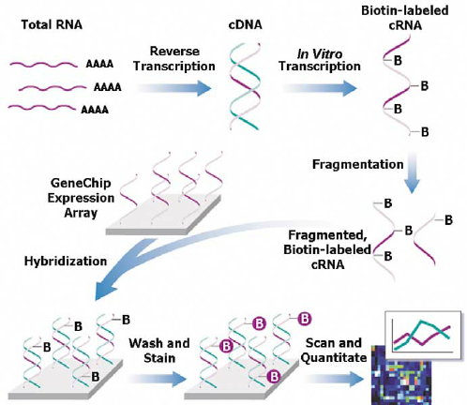
Microarrays Affymetrix arrays
B – biotin, a small molecule that can be recognized by the protein avidin or streptavidin
Probes must be designed to detect known parts of the genome, similar to qPCR

Slide 11
Sequencing, The next generation
Massively parallel, millions to billions of reads per analysis run
A read is a single stretch of sequence
75-150 bases long
500 million reads for $2500
200,000 reads/dollar
Typical read by Sanger method $5 each
But covers 500-1000 bases

Slide 12
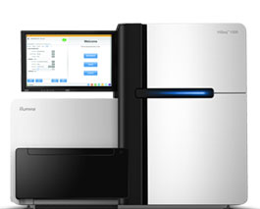
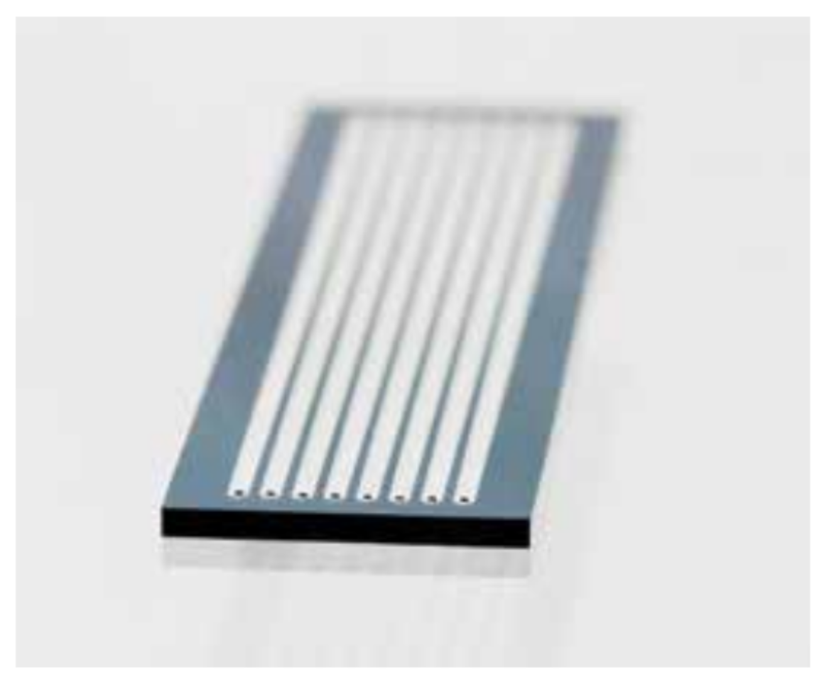
Sequencing, Illumina
On board amplification
In a flow cell
Uses PCR
Florescence based sequencing
Imaging to detect sequence

Slide 13
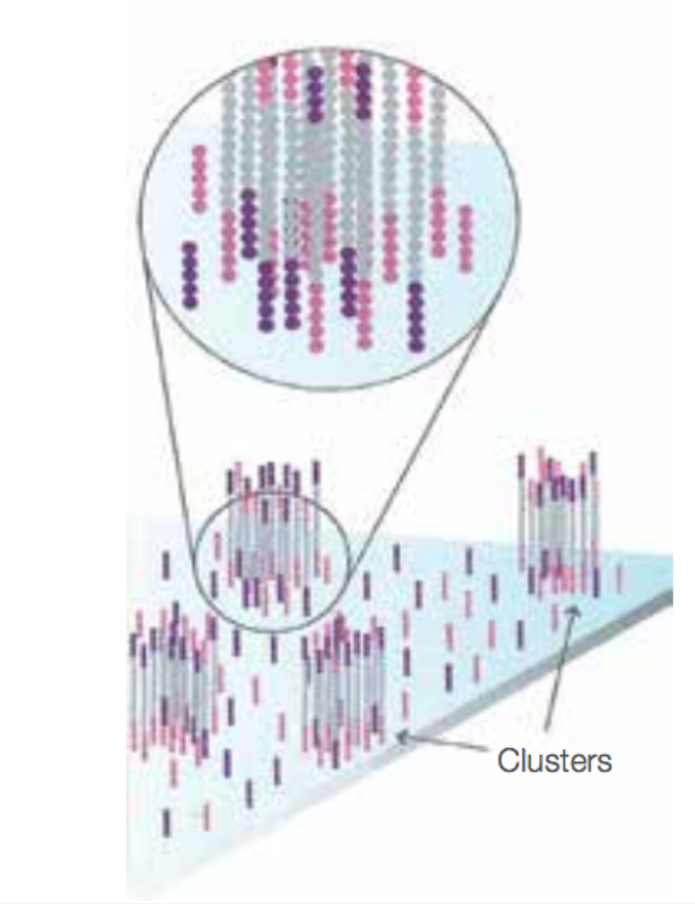
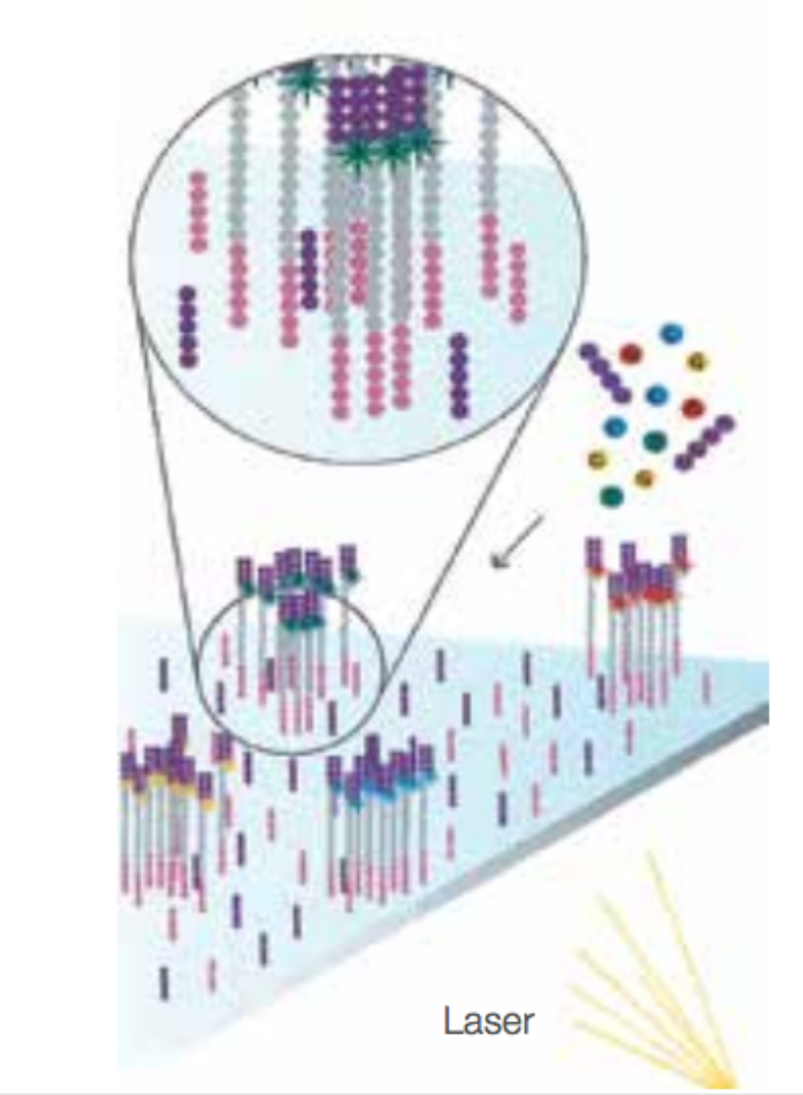
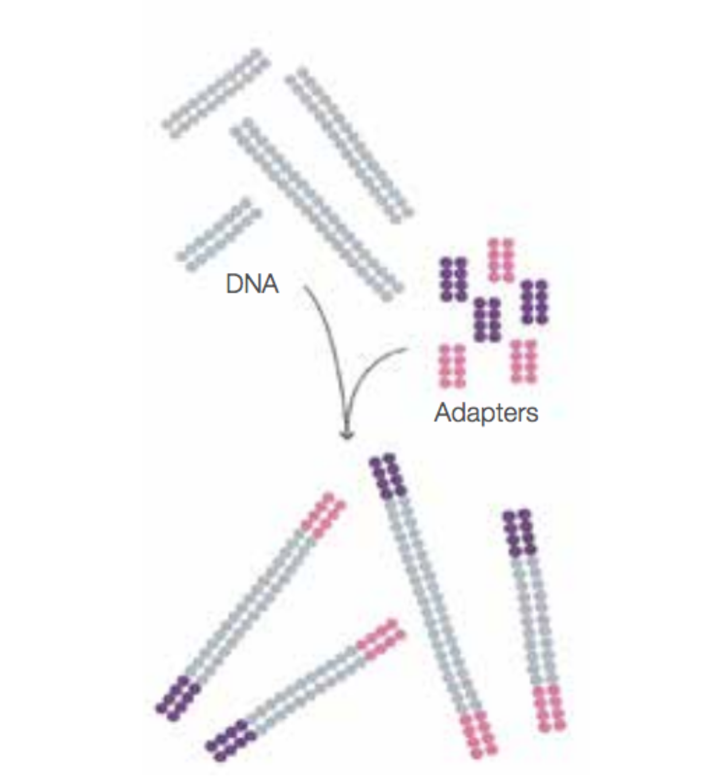
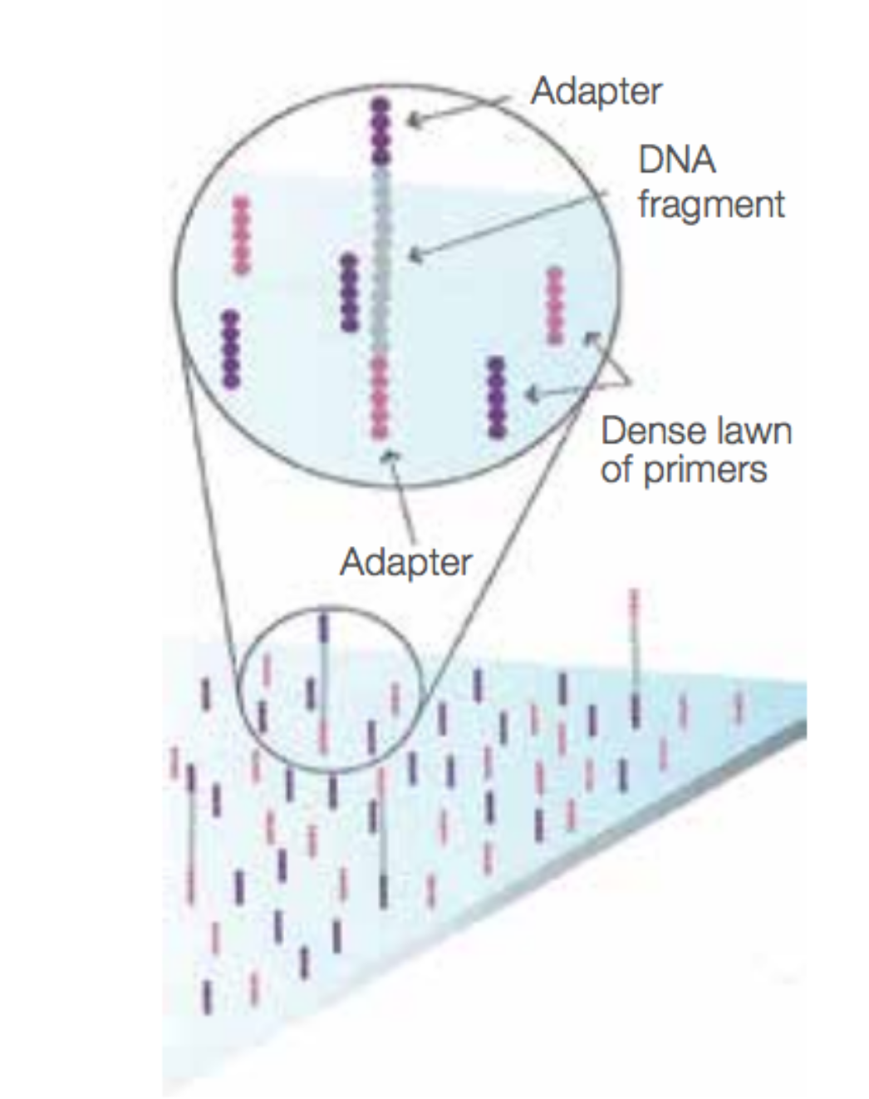
Sequencing, Illumina
Sequences are randomly spaced on a flat surface
Use PCR to build the sequence colony

Slide 14
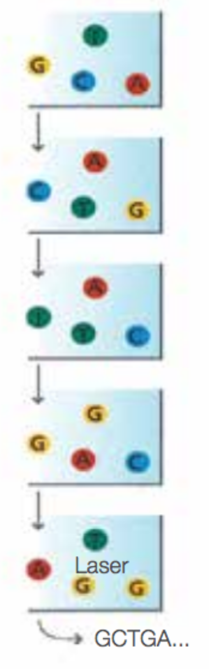
Sequencing cycle
Labeled nucleotides are added
Polymerase incorporates
Each colony should have one new nucleotide added
The flow cell is imaged
The dye is cleaved and washed
Repeat the cycle
The order of the images is the sequence
Round 1
Round 2
Round 3
Round 4
Round 5

Slide 15
FASTQ
Raw sequence data with quality scores

Slide 16
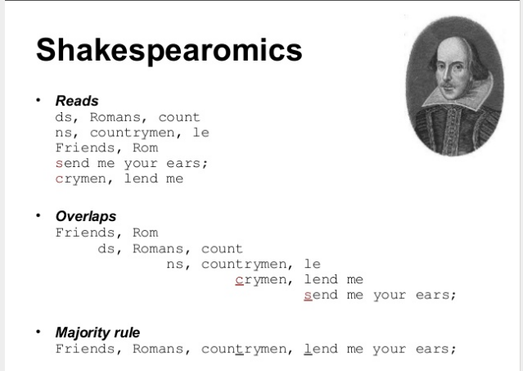
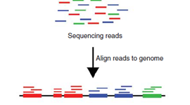
Alignment
FASTQ Format
Many Mapping tools have been developed to assist with mapping of transcriptome data.
These trade speed and accuracy.
BOWTIE2, BWA, TOPHAT, SHRIMP, STAR,GSNAP, HISAT2, SAILFISH

Slide 17
Count table

Slide 18
Gene expression concepts
Normalize or Standardize
Data collected under different conditions
Range (min and max) and means may be different
Must normalize to make equivalent
Normalcy
Is the distribution normal
Transform, typical is log₂
Differential expression
Many methods, linear models, t-test
Must correct or adjust the test statistic, FDR, Bonferoni, etc.
Too many tests, inflates the false positives

Slide 19
Gene expression concepts
Normalize
Data collected under different conditions
Range (min and max) and means may be different
Must normalize to make equivalent
Normalcy
Is the distribution normal
Transform, typical is log₂
Differential expression
Many methods, linear models, t-test
Must correct or adjust the test statistic, FDR, Bonferoni, etc.
Too many tests, inflates the false positives

Slide 20
Gene expression concepts
Normalize
Data collected under different conditions
Range (min and max) and means may be different
Must normalize to make equivalent
Normalcy
Is the distribution normal
Transform, typical is log₂
Differential expression
Many methods, linear models, t-test
Must correct or adjust the test statistic, FDR, Bonferoni, etc.
Too many tests, inflates the false positives

Slide 21
Quantification
Microarrays
Fluorescence detection
Continuous data
RNA-sequencing
Counting, integer
heteroskedasticity, variance is dependent on the mean

Slide 22
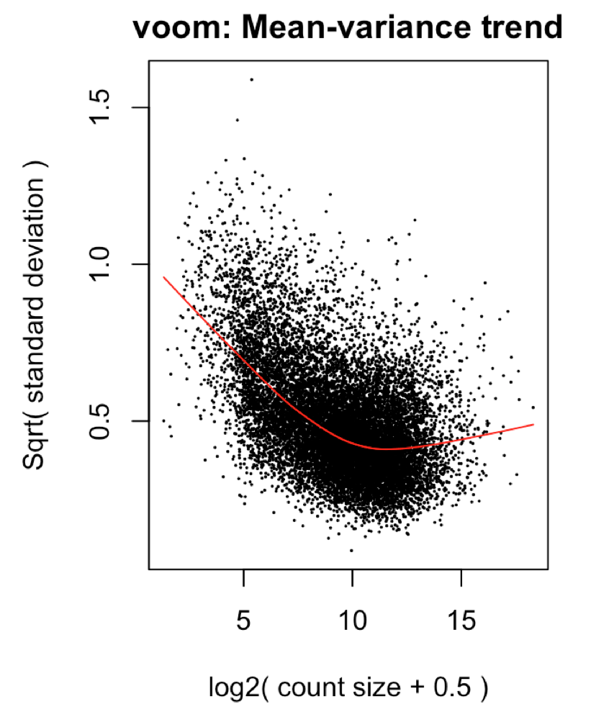
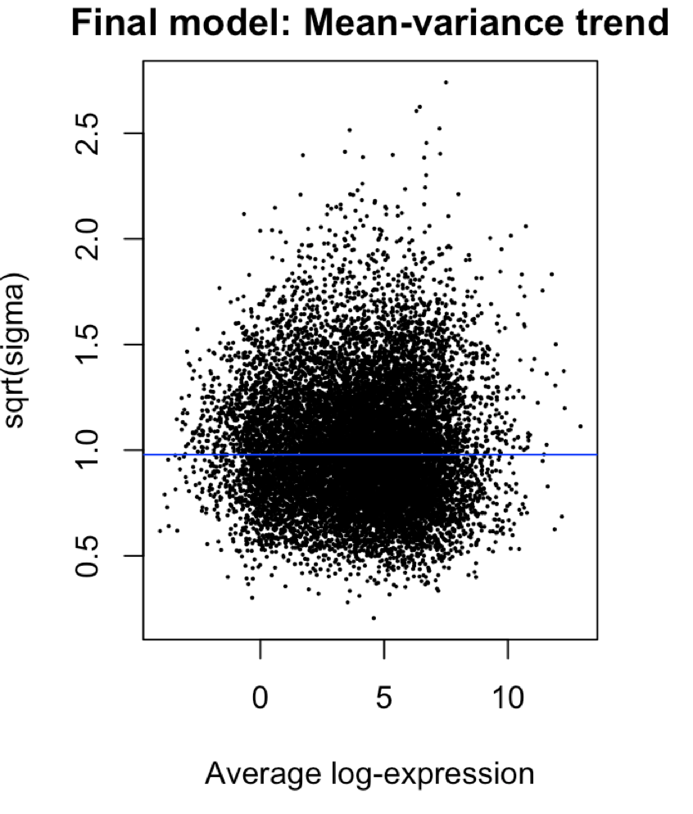
Quantification
Microarrays
Fluorescence detection
Continuous data
RNA-sequencing
Counting, integer
heteroskedasticity, variance is dependent on the mean

Slide 23
Batch effect
After normalization can still have an issue
Batch
A grouping of samples that were analyzed at the same time
The batch effect
Presence of multiple batches
Can affect the measurement of some genes in a batch
Each batch can have its own
Possible sources are
Different day, Lot of reagents, Person performing experiment, Different instrument (same model)

Slide 24
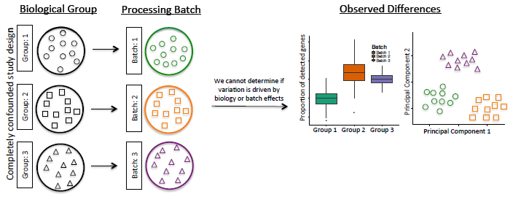
Experimental design
Experimental design can be used to prevent or compensate for the batch effect
Each batch should have all phenotypes represented
If each batch is a unique sample type, controls, treatment) batch effect can not be fixed
Both batch and treatment are the same, Co-variant
Batch Effect:
Technical variation in the processing sample (Batch)
Requires Randomization

Slide 25
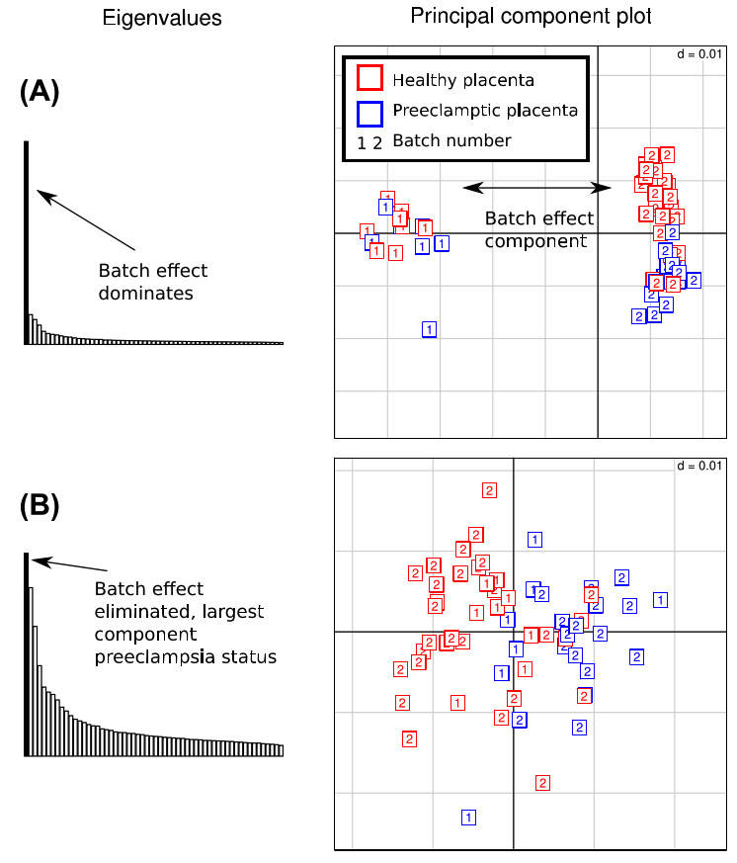
A batch effect
The histogram is the PC % variance
The scatter plot are the samples
Coloured by phenotype
Numbered by batch
After correction the batches intermingle and the dominate component is the phenotype
Can be removed as each batch has both phenotypes represented

Slide 26
General object structure
Microarrays use the ESet (Expression Set) object
A general object type
RNA-seq uses the DGEList (differential gene expression list)
Used by edgeR, limma
There are other object types in other packages
Consists of three main elements
Expression data matrix, columns of samples rows of genes
Phenotype data frame, columns of attributes rows of samples
Feature data frame, columns of attributes, rows of genes

Slide 27
Eset objects

Slide 28
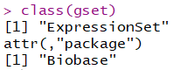
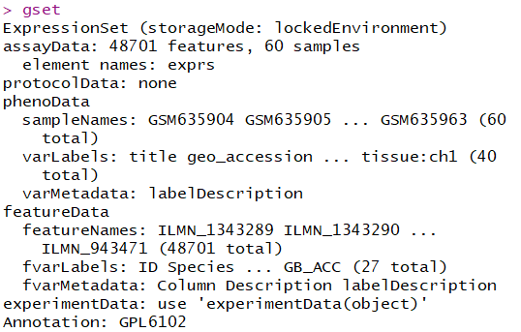
Expression Set Objects
Complex object
Multiple “slots” to access different connected information

Slide 29
Eset
descriptions
samples
descriptions
genes
genes
samples
featureData
fData(eset)
What is the class?
assayData
exprs(eset)
What is the class?
phenotypeData
pData(eset)
What is the class?
Central to the expressionSet is the expression matrix
What is the advantage of keeping these data objects linked?

Slide 30
Eset
samples
The table are held dynamically
Processing the samples table automatically processes the gene expression table
Similar for the feature table and expression table
descriptions
descriptions
samples
genes
genes

Slide 31
DGEList – Differential Gene Expression List
Stores similar information
Uses a list style object
names() accesses the positions
Samples is equivalent to phenotype table
Counts is same as assay data
Genes is same as feature data
> names(x)
[1] "samples" "counts" "genes"

Slide 32
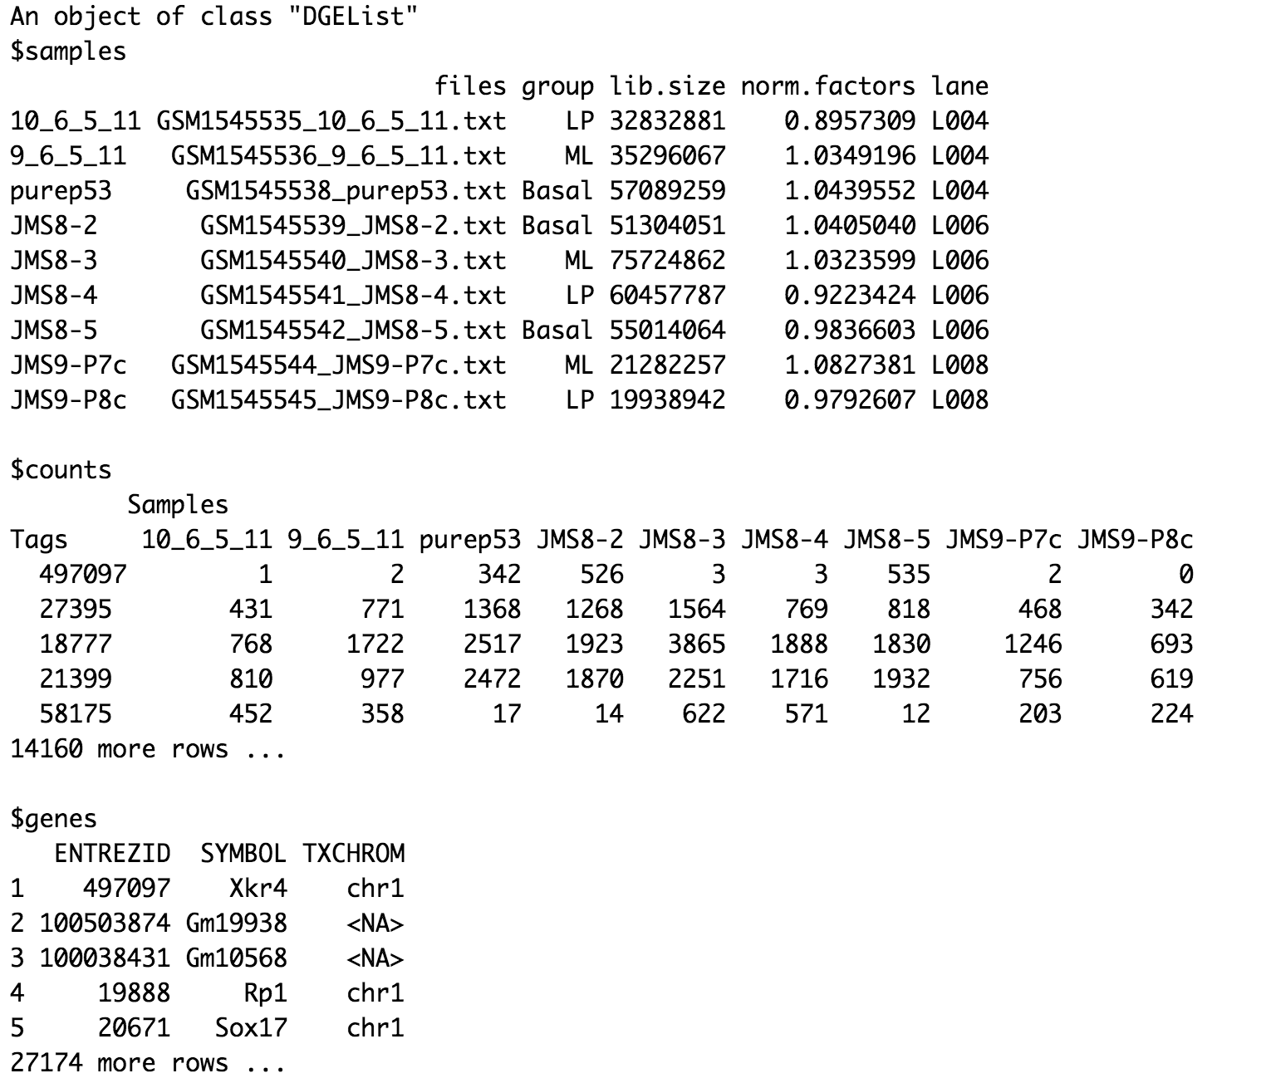
DGEList
Multiple list slots
The samples slot is updated by different functions
lib.size is calculated automatically
Norm.factors are calculated by a funciton

Slide 33
The voom object
Voom is similar to the DGEList object
An EList (Expression List)
Genes is the genes table,
Targets is the samples table
E is the expression matrix
Weights are to transform the data
Design is the the experiment design, samples batches etc.
> names(v)
[1] "genes" "targets" "E”
[4] "weights" "design"

Slide 34
Limma

Slide 35
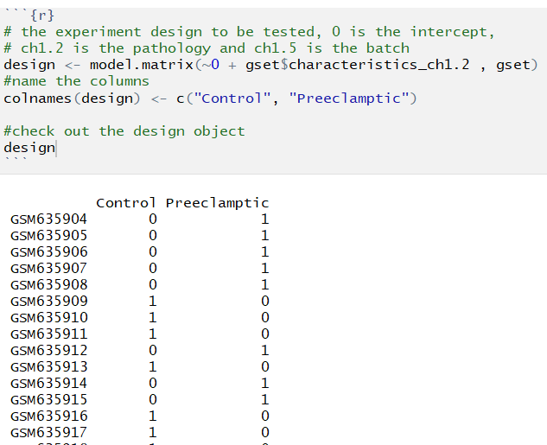
Design matrix
Limma uses linear models
y=mx+b
Sample annotation used
Categorical or continuous variables
Solving for
Differentiation expression
E.g., Healthy vs Sick
Adjusting (for a technical or confounding variable, batch, weight, age etc)

Slide 36
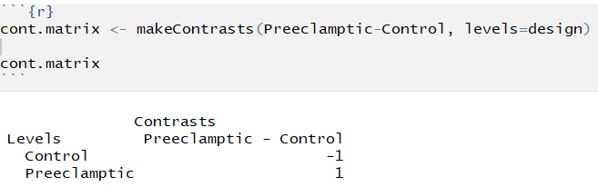
Contrast matrix
The question you are asking
Data is log transformed
Log(a/b)
Log(a) – Log(b)
All values in the design matrix are modelled
If not part of the contrast they are used as a adjustments/corrections
Order affects direction of change
What is up or down?

Slide 37
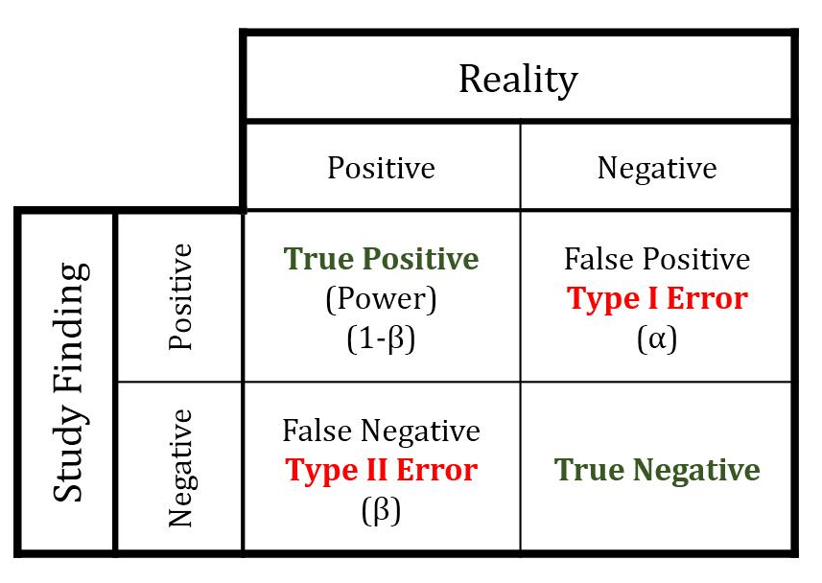
Differential expression
Lots of tests
Need to reconsider errors
Type I, False positives
Type II, False negatives
If you test 1 comparison, a p-value of 0.05 means
A 5% chance that this could be discovered by chance given the data’s distributions.
Note reducing type I error (lower p values) increases type II error
Family wise error rate
Adjust the p-value to account for all of these tests
Family wise error rate
1-(.95)^{n}
N is the number of tests
2 tests is a 0.0975 frequency of false discovery

Slide 38
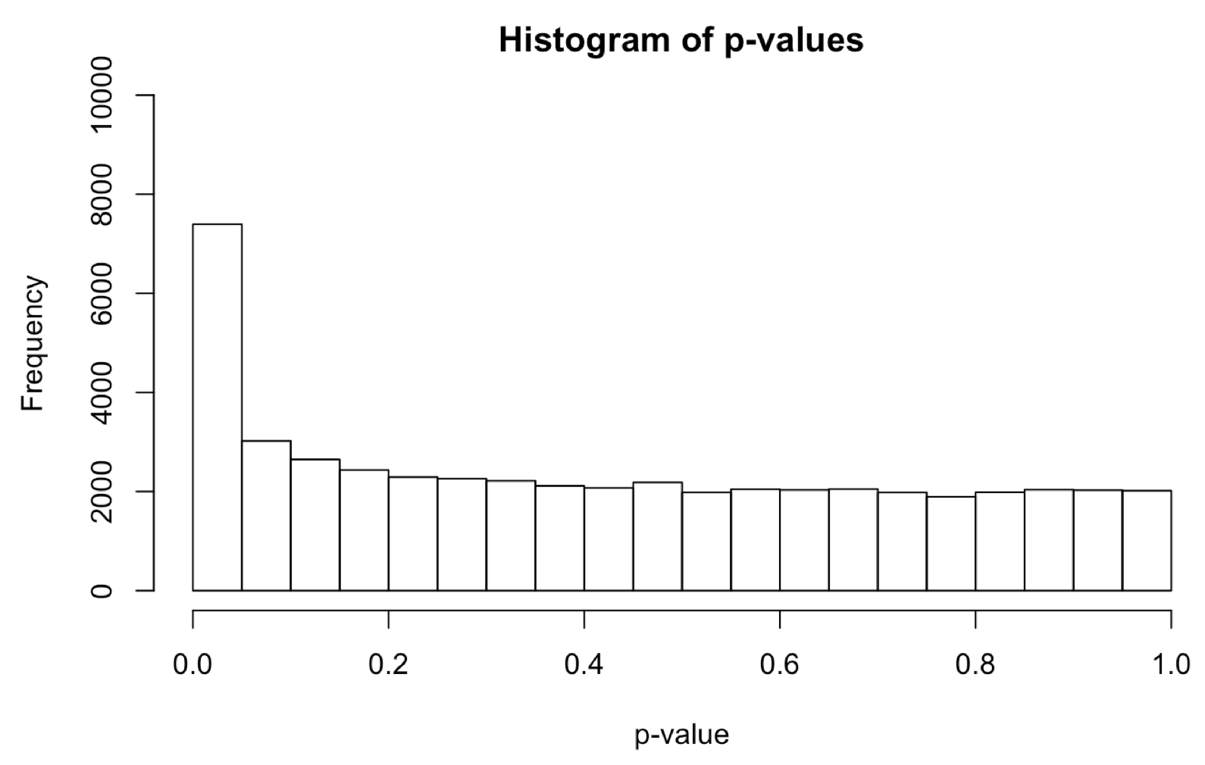
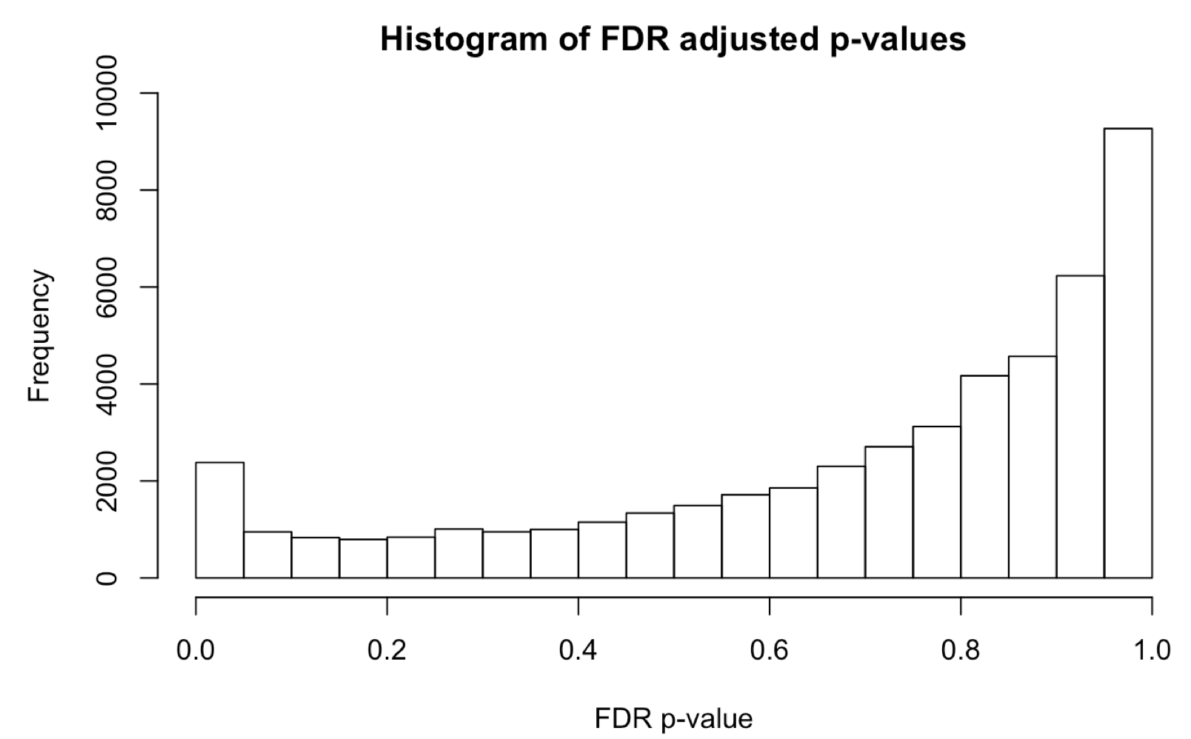
A tail of two p-values
Adjusting can be as simple as dividing
0.05/20,000 = 2.5 x 10⁻⁶, new threshold
But we generally apply other methods like
FDR, Bonferoni, Holm
These will give different results
Considered conservative or liberal

Slide 39
Summary gene expression
Assay of the RNA in cells/tissues
Avoid or track and correct for batches
Adjust for possible confounding variables
Adjust the p-value for multiple testing

